Slide 1


Built-in Functions
Functions and Wildcards in SQL Server
SoftUni Team
Technical Trainers
Software University
https://softuni.bg

Slide 2
Table of Contents
Function Overview
String Functions
Math Functions
Date Functions
Other Useful Functions
Wildcards
2

Slide 3
Questions
sli.do #csharp-db

Slide 4

Functions in SQL Server
Overview

Slide 5
SQL Functions
Aggregate functions
It perform a calculation on a set of values and return a single value
Examples: AVG, COUNT, MIN, MAX, SUM
Analytic functions
It compute an aggregate value based on a group of rows
Unlike aggregate functions, analytic functions can return multiple rows for each group
PERCENTILE_CONT(0.5) WITHIN GROUP (ORDER BY Salary DESC) OVER (PARTITION BY DepartmentId) AS MedianCont

Slide 6
SQL Functions
Ranking functions
Returns a ranking value for each row in a partition
RANK, ROW_NUMBER, DENSE_RANK, NTILE (OVER)
Rowset functions
Returns an object that can be used like table references in a statement
OPENDATASOURCE, OPENJSON, OPENXML, OPENROWSET
Scalar functions
Operate on a single value and then return a single value. Scalar functions can be used wherever an expression is valid

Slide 7

String Functions

Slide 8
String Functions (1)
Concatenation – combines strings
CONCAT replaces NULL values with empty string
CONCAT_WS combines strings with separator
SELECT FirstName + ' ' + LastName
AS [Full Name]
FROM Employee
SELECT CONCAT(FirstName, ' ', LastName)
AS [Full Name]
FROM Employee

Slide 9
String Functions (2)
SUBSTRING – extracts a part of a string
Example: get short summary of an article
SUBSTRING(String, StartIndex, Length)
SUBSTRING('SoftUni', 5, 3)
Uni
SELECT ArticleId, Author, Content,
SUBSTRING(Content, 1, 200) + '...' AS Summary
FROM Articles

Slide 10
String Functions (3)
REPLACE – replaces a specific string with another
Example: censor the word blood from album names
REPLACE(String, Pattern, Replacement)
REPLACE('SoftUni', 'Soft', 'Hard')
HardUni
SELECT REPLACE(Title, 'blood', '*****’)
AS Title
FROM Album

Slide 11
String Functions (4)
LTRIM & RTRIM – remove spaces from either side of string
LEN – counts the number of characters
DATALENGTH – gets the number of used bytes
LTRIM(String)
RTRIM(String)
LEN(String)
DATALENGTH(String)

Slide 12
String Functions (5)
LEFT & RIGHT – get characters from the beginning or the end of a string
Example: name shortened (first 3 letters)
LEFT(String, Count)
RIGHT(String, Count)
SELECT Id, Start,
LEFT(Name, 3) AS Shortened
FROM Games

Slide 13
String Functions (6)
LOWER & UPPER – change letter casing
REVERSE – reverses order of all characters in a string
REPLICATE – repeats a string
FORMAT – format a value with a valid .NET format string
LOWER(String)
UPPER(String)
REVERSE(String)
REPLICATE(String, Count)
FORMAT(SomeDate, 'yyyy-MMMM-dd', 'bg-BG')

Slide 14
Problem: Obfuscate CC Numbers
Our database contains credit card details for customers
Provide a summary without revealing the serial numbers
ID | FirstName | LastName | PaymentNumber
1 | Guy | Gilbert | 5645322227179083
2 | Kevin | Brown | 4417937746396076
… | … |  | …
ID | FirstName | LastName | PaymentNumber
1 | Guy | Gilbert | 564532**********
2 | Kevin | Brown | 441793**********
… | … |  | …

Slide 15
Solution : Obfuscate CC Numbers
We reveal the first 6 digits and obfuscate the rest
Bonus – create a View for the use of clients
SELECT CustomerID,
FirstName,
LastName,
LEFT(PaymentNumber, 6) + '**********'
FROM Customers
CREATE VIEW v_PublicPaymentInfo AS
…

Slide 16
String Functions (7)
CHARINDEX – locates a specific pattern (substring) in a string
STUFF – inserts a substring at a specific position
Optional, begins at 1
CHARINDEX(Pattern, String, [StartIndex])
STUFF(String, StartIndex, Length, Substring)
Number of chars
to delete

Slide 17

Math Functions
Arithmetic, PI, ABS, ROUND, Etc.

Slide 18
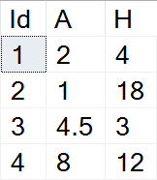
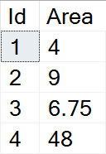

Math Functions (1)
SQL Server supports basic arithmetic operations
Example: find the area of triangles by the given side and height
SELECT Id,
(A*H)/2 AS Area
FROM Triangles

Slide 19
Math Functions (2)
PI – gets the value of Pi as a float (15 –digit precision)
ABS – absolute value
SQRT – square root (the result will be float)
SQUARE – raise to power of two
SELECT PI() --3.14159265358979
ABS(Value)
SQRT(Value)
SQUARE(Value)

Slide 20
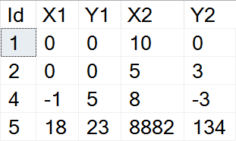
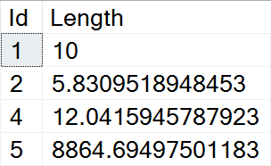
Example: Line Length
Find the length of a line by given coordinates of the end points
SELECT Id,
SQRT(SQUARE(X1-X2) + SQUARE(Y1-Y2))
AS Length
FROM Lines

Slide 21
Math Functions (3)
POWER – raises value to the desired exponent
ROUND – obtains the desired precision
Negative precision rounds characters before the decimal point
FLOOR & CEILING – return the nearest integer
POWER(Value, Exponent)
ROUND(Value, Precision)
FLOOR(Value)
CEILING(Value)

Slide 22
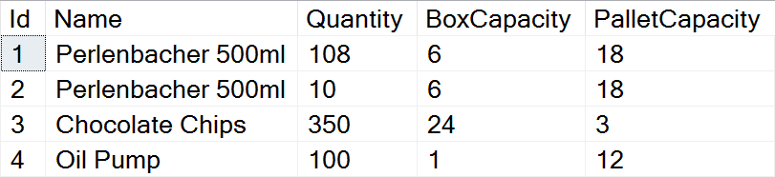
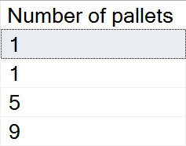
Problem: Pallets
Calculate the required number of pallets to ship each item
BoxCapacity specifies how many items can fit in one box
PalletCapacity specifies how many boxes can fit in a pallet

Slide 23
Solution: Pallets
Since we can't use half a box or half a pallet, we need to round up to the nearest integer value
SELECT
CEILING(
CEILING(
CAST(Quantity AS float) /
BoxCapacity) / PalletCapacity)
AS [Number of pallets]
FROM Products

Slide 24
Math Functions (4)
SIGN – returns 1, -1 or 0, depending on the value of the sign
RAND – gets a random float value in the range [0, 1]
If Seed is not specified, it will be assigned randomly
SIGN(Value)
RAND()
RAND(Seed)

Slide 25

Date Functions
GETDATE, DATEDIFF, DATEPART, Etc.

Slide 26
Date Functions (1)
DATEPART – extract a segment from a date as an integer
Part can be any part and format of date or time
For a full list, take a look at the official documentation
DATEPART(Part, Date)
year, yyyy, yy
YEAR(Date)
month, mm, m
MONTH(Date)
day, dd, d
DAY(Date)

Slide 27
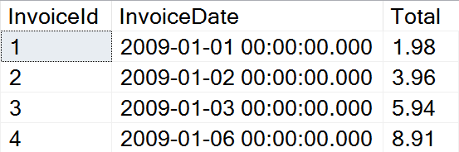
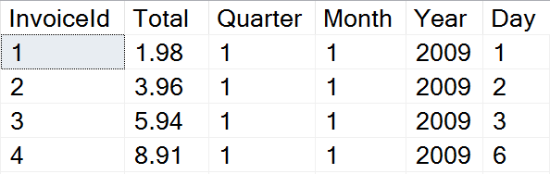
Problem: Quarterly Report
Prepare sales data for aggregation by displaying yearly quarter, month, year and day of sale

Slide 28
Solution: Quarterly Report
Use DATEPART to get the relevant parts of the date
This statement might be useful as a View
SELECT InvoiceId, Total,
DATEPART(QUARTER, InvoiceDate) AS Quarter,
DATEPART(MONTH, InvoiceDate) AS Month,
DATEPART(YEAR, InvoiceDate) AS Year,
DATEPART(DAY, InvoiceDate) AS Day
FROM Invoice

Slide 29
Date Functions (2)
DATEDIFF – finds the difference between two dates
Part can be any part and format of date or time
Example: Show employee experience
DATEDIFF(Part, FirstDate, SecondDate)
SELECT ID, FirstName, LastName,
DATEDIFF(YEAR, HireDate, '2017/01/25')
AS [Years In Service]
FROM Employees

Slide 30
Date Functions (3)
DATENAME – gets a string representation of a date's part
DATEADD – performs date arithmetic
Part can be any part and format of date or time
GETDATE – obtains the current date and time
EOMONTH – returns the last day of the month
DATENAME(Part, Date)
SELECT DATENAME(weekday, '2017/01/27')
DATEADD(Part, Number, Date)
SELECT GETDATE()

Slide 31


Other Functions
CAST, CONVERT, OFFSET, FETCH

Slide 32
Other Functions (1)
CAST & CONVERT – conversion between data types
ISNULL – swaps NULL values with a specified default value
Example: Display “Not Finished” for projects with no EndDate
CAST(Data AS NewType)
CONVERT(NewType, Data)
ISNULL(Data, DefaultValue)
SELECT ProjectID, Name,
ISNULL(CAST(EndDate AS varchar), 'Not Finished')
FROM Projects

Slide 33
Other Functions (2)
COALESCE – evaluates the arguments in order and returns the current value of the first expression that initially does not evaluate to NULL
SELECT COALESCE(NULL, NULL, 'third_value', 'fourth_value');
// third_value

Slide 34
Other Functions (3)
OFFSET & FETCH – get only specific rows from the result set
Used in combination with ORDER BY for pagination
SELECT ID, FirstName, LastName
FROM Employees
ORDER BY ID
OFFSET 10 ROWS
FETCH NEXT 5 ROWS ONLY
Rows to skip
Rows to include

Slide 35
Ranking Functions
ROW_NUMBER – always generate unique values without any gaps, even if there are ties
RANK – can have gaps in its sequence and when values are the same, they get the same rank
DENSE_RANK – returns the same rank for ties, but it doesn’t have any gaps in the sequence
NTILE – Distributes the rows in an ordered partition into a specified number of groups

Slide 36

Wildcards
Selecting Results by Partial Match

Slide 37
Using WHERE … LIKE
Wildcards are used with WHERE for partial filtration
Similar to Regular Expressions, but less capable
Example: Find all employees who's first name starts with "Ro"
SELECT ID, FirstName, LastName
FROM Employees
WHERE FirstName LIKE 'Ro%'
Wildcard symbol

Slide 38
Wildcard Characters
Supported characters include:
ESCAPE – specify a prefix to treat special characters as normal
% -- any string, including zero-length
_ -- any single character
[…] -- any character within range
[^…] -- any character not in the range
SELECT ID, Name
FROM Tracks
WHERE Name LIKE '%max!%' ESCAPE '!'

Slide 39

Summary
…
…
…
Various built-in functions
String functions - CONCAT, LEFT/RIGHT, REPLACE, etc.
Math functions - PI, ABS, POWER, ROUND, etc.
Date functions - DATEPART, DATEDIFF, GETDATE, etc.
Using Wildcards, we can obtain results by partial string matches

Slide 40












SoftUni Diamond Partners

Slide 41


Educational Partners

Slide 42
Questions?
Notes:
42

Slide 43
Trainings @ Software University (SoftUni)
Software University – High-Quality Education, Profession and Job for Software Developers
softuni.bg, about.softuni.bg
Software University Foundation
softuni.foundation
Software University @ Facebook
facebook.com/SoftwareUniversity
Software University Forums
forum.softuni.bg
43
Notes:
43

Slide 44

License
This course (slides, examples, demos, exercises, homework, documents, videos and other assets) is copyrighted content
Unauthorized copy, reproduction or use is illegal
© SoftUni – https://about.softuni.bg
© Software University – https://softuni.bg
Notes:
44

